Slide 1
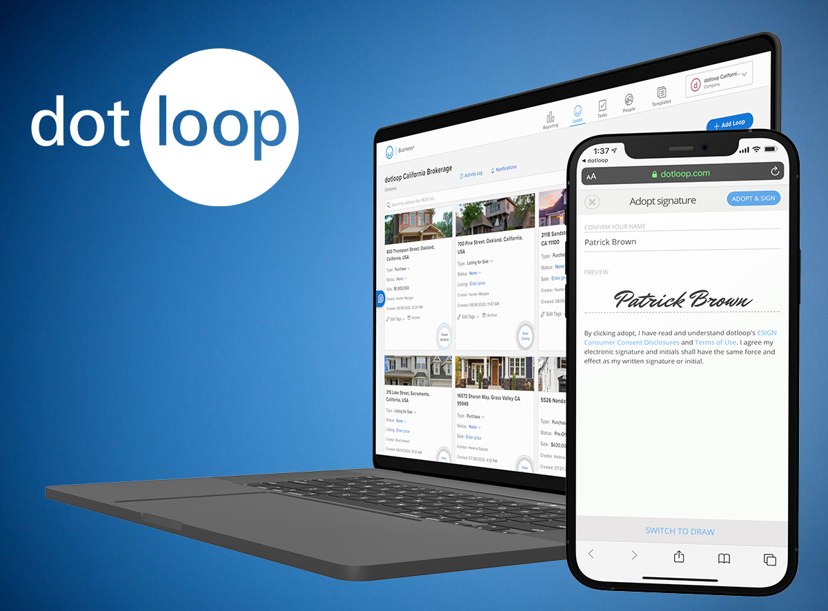
dotloop
Your All-in-One
Transaction Management Partner
Dotloop’s leading transaction management software connects agents, transaction coordinators, admins and customers on one collaborative platform to edit, eSign and share documents; gain compliance; and close deals faster and more efficiently. In online banking, you wouldn’t use a different app to transfer funds, another one to deposit, and yet another to pay bills. So why would you use different apps to manage your transactions? Dotloop is the real estate industry’s one start-to-finish, contract-to-close transaction management platform that brings all of the following together on one turnkey platform:
Comprehensive association forms coverage
Unlimited eSignatures with multiple ways to sign - text, email & in-person
Document Templates - customized to how you work
Loop Templates – the ultimate productivity tool
Automated Tasks - customize and assign people and dates
Submit for Review - mobile or desktop
Compliance Workflows - customized and automated
75+ Integrations with leading real estate software partners
Five star-rated mobile app to make offers, edit, eSign, submit for review & text docs
Free training on your terms - online, private 1:1s, video, certifications and more!
How to Get Started
The office admin will email you a setup email
Create your login from the email
Go to https://www.dotloop.com/resource-center/training/ for online videos & tutorials
Notes:
PRO TIP
Send your recruitment paperwork via dotloop to new recruits to get them comfortable with the transaction management software from Day One. Dotloop’s onboarding tool offers a tasks checklist that makes it easy for new hires to fill out and sign online paperwork, including 1099s and non-disclosure agreements, all of which can be stored within preset templates. You can even upload photographs of interviewing prospects with their resumes to organize and manage the hiring process. With dotloop’s five star-rated mobile app, the agents can eSign, submit and store all their onboarding paperwork wherever they want.

